Slide 1

CMPT 2400, 3510
Data Preparation Analytics and Machine Learning
National Pollutant Release Inventory Project

Slide 2

Team Members
Deepkanwal Singh
Sukhjinder Kaur
Muskaanpreet Kaur

Slide 3
Problem Statement & Objectives
Problem Statement: What are predicted releases of nitrogen oxides and carbon monoxide from the oil and gas extraction sector (NAICS code 211110) in 2023 if the price of oil goes up or down?
Objectives:
Develop predictive models for NOₓ and CO emissions based on oil price changes.
Provide actionable insights for stakeholders in the oil and gas sector.

Slide 4
Data Preparation & Analysis

Slide 5
Data Cleaning & Preprocessing
Cleaning Steps:
Handling missing values
Removing duplicates or irrelevant entries
Outlier Treatment:
Techniques used (e.g., IQR-based filtering)
Rationale:
Ensuring reliable input for modeling.

Slide 6
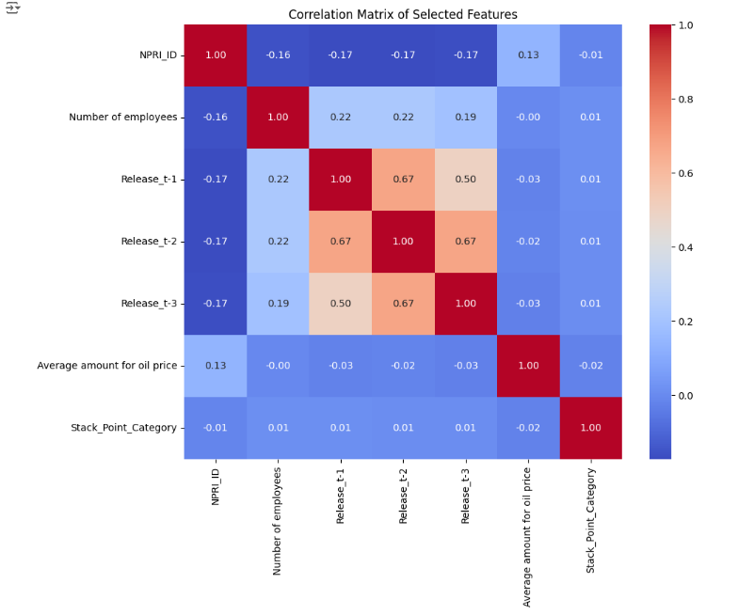
Exploratory Data Analysis (EDA)
Key Insights:
Distribution of NOₓ and CO emissions
Relationship between oil prices and emissions
Visual Highlights:
Correlation heatmap between features
Scatter plots showing emissions vs. oil prices.
Outcome:
Identification of potential predictive variables

Slide 7
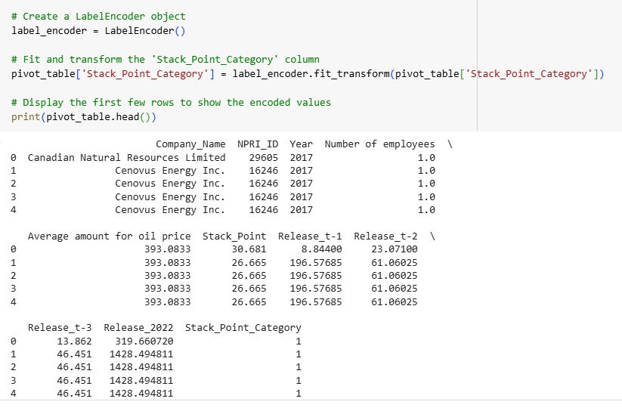
Normalization & Encoding
Normalization:
Methods used (StandardScaler)
Impact on numerical features
Encoding Categorical Variables:
Techniques like Label Encoding for categorical data
Insight:
Enhanced model input consistency and performance

Slide 8
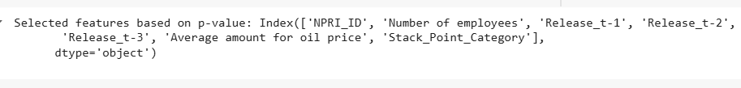
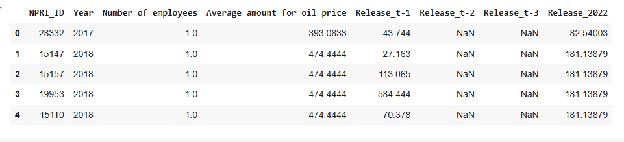
Feature Selection & Engineering
Feature Selection:
Techniques used were the P-value and Pearson correlation methods.
Feature Engineering:
Creating new features (e.g., lagged release amount, Release for 2022 as a label, and Release 2023 as predicted amount)
Outcome:
Enhanced model accuracy and reduced dimensionality

Slide 9
Machine Learning Modeling

Slide 10
Model Candidates & Training
Models Considered:
Random Forest, Gradient Boosting Machines, KNN, Decision Tree.
Training Process:
Train/Test splits
Cross-validation strategy (e.g., K-Fold)
Hyperparameter Tuning:
Methods used (Random Search)

Slide 11
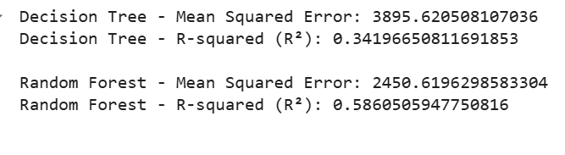
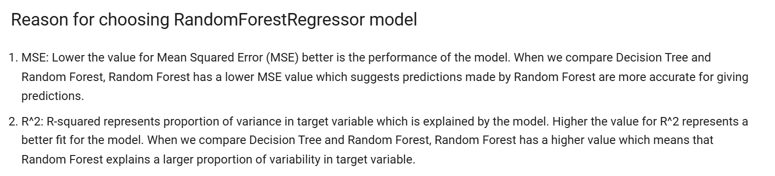
Best Model & Results
Comparison of Models:
Metrics Chosen:
Mean Squared Error(MSE), R² Score

Slide 12
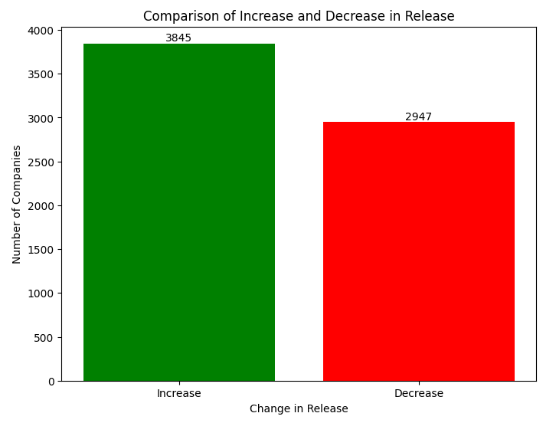
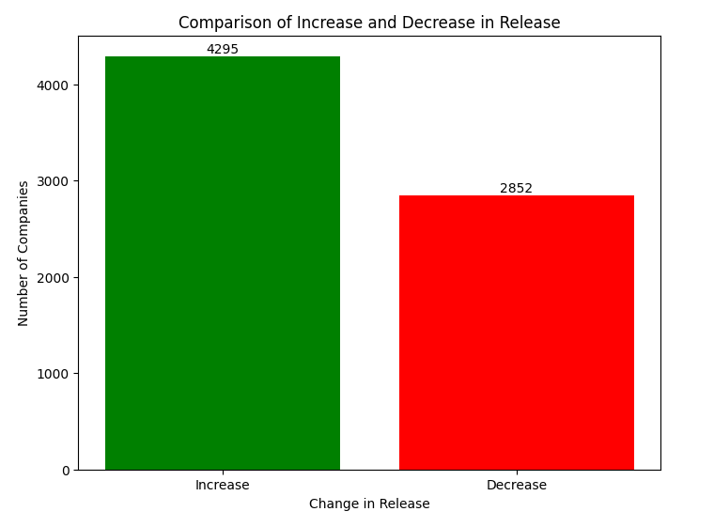
Insights
Comparison of Models:
Carbon Monoxide
Nitrogen Oxide

Slide 13
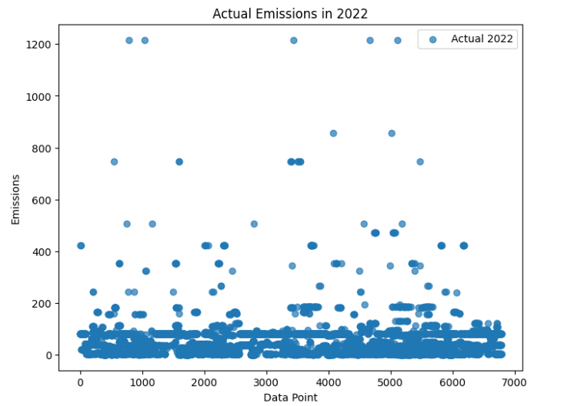
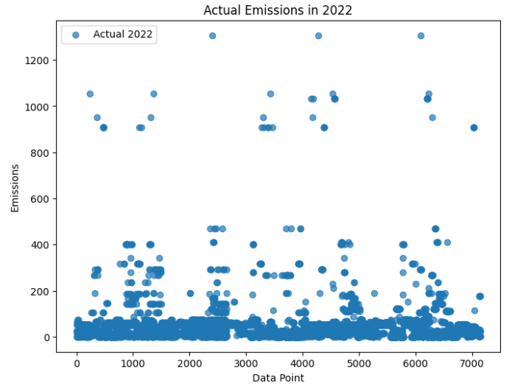
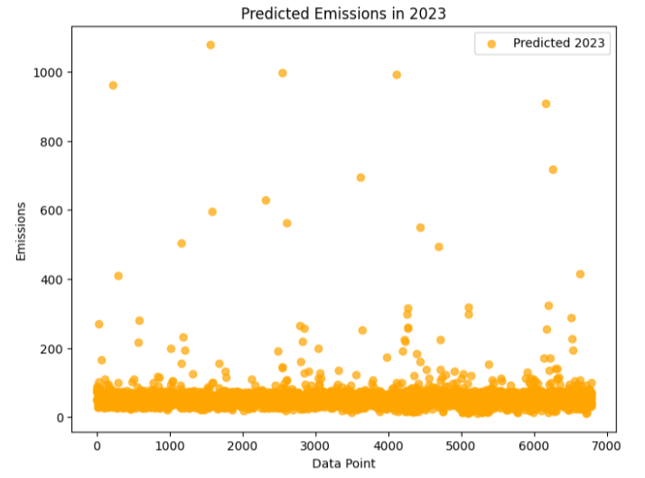
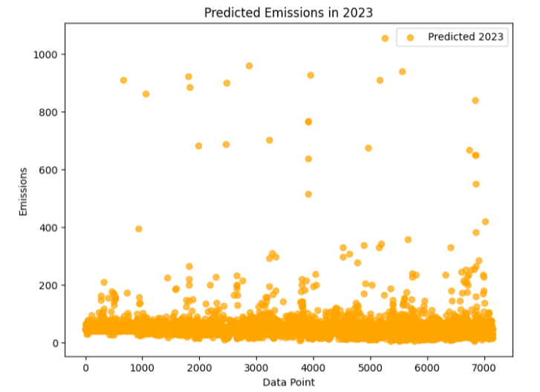
Carbon Monoxide
Nitrogen Oxide

Slide 14
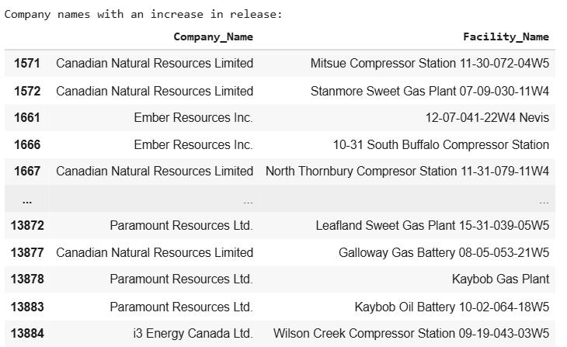
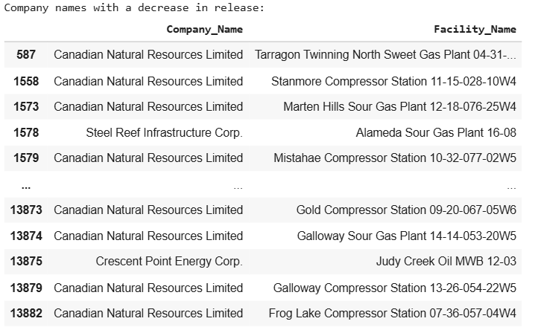
Predictions for Carbon Monoxide

Slide 15
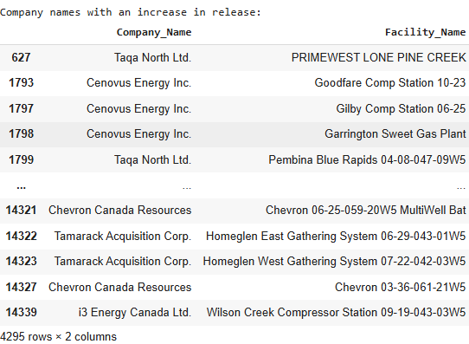
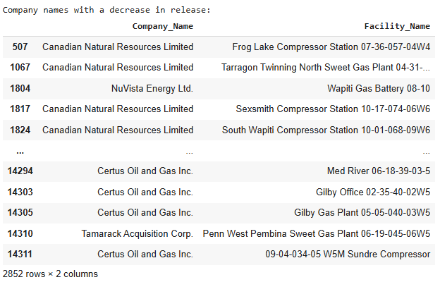
Predictions for Nitrogen Oxide

Slide 16

Questions?
Notes:
After questions jump into Unit 1

